Slide 1

Data Science
L A Deshpande
leena.deshpande@viit.ac.in
Department of Computer Engineering
BRACT’S, Vishwakarma Institute of Information Technology, Pune-48
(An Autonomous Institute affiliated to Savitribai Phule Pune University)
(NBA and NAAC accredited, ISO 9001:2015 certified)

Slide 2
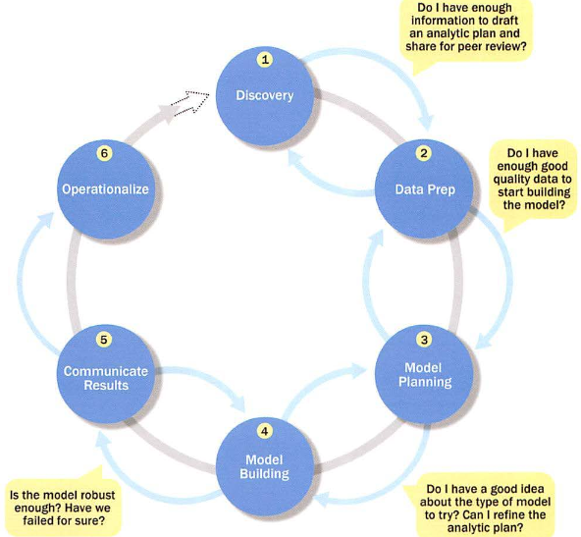
Contents covered :Overview of Data Analytics Lifecycle

Slide 3
Unit-II
Statisical Inference of Data

Slide 4
Unit II : | Statistical Inference of Data
Statistical Methods for Evaluation- Hypothesis testing, mean, mode, median, random variables (discrete and continuous), expected value, correlation, variance, standard deviation, limit theorem, difference of means

Slide 5
Statistical Methods for Evaluation- Hypothesis testing, difference of means, wilcoxon rank–sum test, type 1 type 2 errors, power and sample size, ANNOVA.
Advanced Analytical Theory and Methods: Clustering- Overview, K means- Use cases, Overview of methods, determining number of clusters, diagnostics, reasons to choose and cautions.

Slide 6
Statistical Methods for Evaluation
Visualization is useful for data exploration and presentation, but statistics is crucial because it may exist throughout the entire Data Analytics Lifecycle.
Statistical techniques are used during the initial data exploration and data preparation, model building, evaluation of the final models, and assessment of how the new models improve the situation when deployed in the field.

Slide 7
In particular, statistics can help answer the following questions for data analytics:
• Model Building and Planning
What are the best input variables for the model?
Can the model predict the outcome given the input?
Model Evaluation
Is the model accurate?
Does the model perform better than an obvious guess?
Does the model perform better than another candidate model?
Model Deployment
Is the prediction sound?
Does the model have the desired effect (such as reducing the cost}?

Slide 8
Hypothesis Testing
When comparing populations, such as testing or evaluating the difference of the means from two samples of data (Figure 2-1), a common technique to assess the difference or the significance of the difference is hypothesis testing.

Slide 9
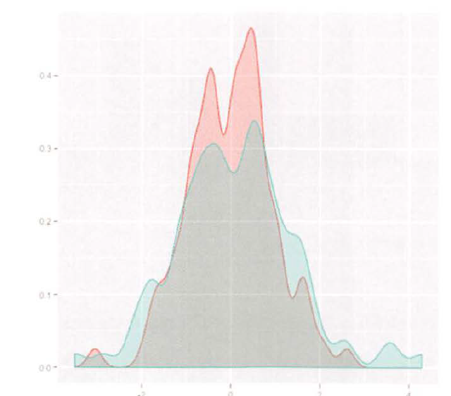
Fig-2.1 Distributions of two samples of data

Slide 10
The basic concept of hypothesis testing is to form an assertion and test it with data.
When performing hypothesis tests, the common assumption is that there is no difference between two samples.
This assumption is used as the default position for building the test or conducting a scientific experiment.
Statisticians refer to this as the null hypothesis (H0).
The alternative hypothesis (H) is that there is a difference between two samples.

Slide 11
It is important to state the null hypothesis and alternative hypothesis, because misstating them is likely to undermine the subsequent steps of the hypothesis testing process.
A hypothesis test leads to either rejecting the null hypothesis in favor of the alternative or not rejecting the null hypothesis.

Slide 12
Once a model is built over the training data, it needs to be evaluated over the testing data to see if the proposed model predicts better than the existing model currently being used.
The null hypothesis is that the proposed model does not predict better than the existing model.
The alternative hypothesis is that the proposed model indeed predicts better than the existing model.
In accuracy forecast, the null model could be that the sales of the next month are the same as the prior month.
The hypothesis test needs to evaluate if the proposed model provides a better prediction.

Slide 13
For example, if the task is to identify the effect of drug A compared to drug B on patients, the null hypothesis and alternative hypothesis would be this.
H0: Drug A and drug B have the same effect on patients.
HA: Drug A has a greater effect than drug B on patients.
If the task is to identify whether advertising Campaign C is effective on reducing customer churn, the null hypothesis and alternative hypothesis would be as follows.
H0: Campaign C does not reduce customer churn better than the current campaign method.
HA : Campaign C does reduce customer churn better than the current campaign.

Slide 14
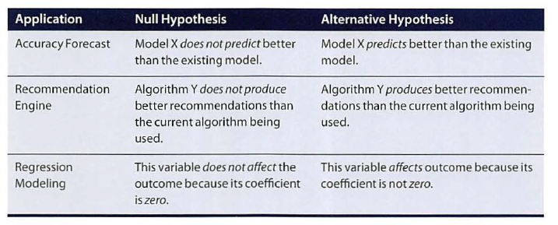
Example Null Hypotheses and Alternative Hypotheses

Slide 15
Take a recommendation engine as an example.
The null hypothesis could be that the new algorithm does not produce better recommendations than the current algorithm being deployed.
The alternative hypothesis is that the new algorithm produces better recommendations than the old algorithm.
When evaluating a model, sometimes it needs to be determined if a given input variable improves the model.

Slide 16
In regression analysis, for example, this is the same as asking if the regression coefficient for a variable is zero.
The null hypothesis is that the coefficient is zero, which means the variable does not have an impact on the outcome.
The alternative hypothesis is that the coefficient is nonzero, which means the variable does have an impact on the outcome.
A common hypothesis test is to compare the means of two populations.

Slide 17
Terms
Population ≡ all possible values
Sample ≡ a portion of the population
Statistical inference ≡ generalizing from a sample to a population with calculated degree of certainty
Two forms of statistical inference
Hypothesis testing
Estimation
Parameter ≡ a characteristic of population, e.g., population mean µ
Statistic ≡ calculated from data in the sample, e.g., sample mean ( )
Notes:
Hypothesis testing is one of the two common forms of statistical inference. This slide reviews some of the terms that form the basis of statistical inference, as introduced in the prior chapter. Make certain you understand these basics before proceeding.

Slide 18
Mean , Median, Mode,
Mean is the average of all measure values within a data set.
Median is the central number that splits a data set into two equal parts based on a specific measure.
Mode represents the measure that occurs maximum number of times within a data set.

Slide 19
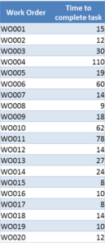
Example: Find out avg work done and time to complete the work

Slide 20
Mean is 27.7
Median is 14.5 and
Mode is 14
Analysis : the average time taken to close a Work Order is 27.7 minutes and out of 20 work orders 10 work orders were closed under 14.5 minutes and remaining took more than 14.5 minutes and the maximum number of Work Orders that were closed by duration took 14 minutes.

Slide 21
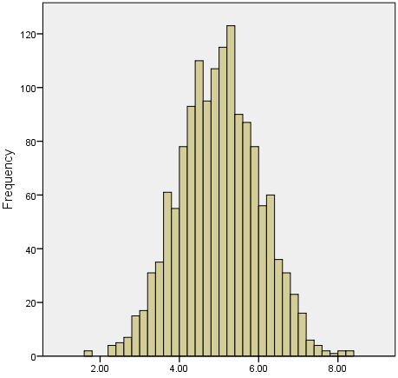
When to use Mean
when your data distribution is continuous and symmetrical

Slide 22
When not to use the mean
In case of outliers
Small and large numerical values in data (no uniformity in data representation)
Consider data of staff salary
Mean salary:30.7K. It Is not the best value as most workers sal between 12k to 16K
1 | 2 | 3 | 4 | 5 | 6 | 7 | 8 | 9 | 10
15 | 18 | 16 | 14 | 15 | 15 | 12 | 17 | 90 | 95

Slide 23
Better way?
Median
15
18
161515
18
16
14
15
15
12
17
90
18
16
14
15
1dian is n+1/2
90
14
15
15
12
17
90
1 | 2 | 3 | 4 | 5 | 6 | 7 | 8 | 9 | 10
15 | 18 | 16 | 14 | 15 | 15 | 12 | 17 | 90 | 95
1 | 2 | 3 | 4 | 5 | 6 | 7 | 8 | 9 | 10
12 | 14 | 15 | 15 | 15 | 16 | 17 | 18 | 90 | 95

Slide 24
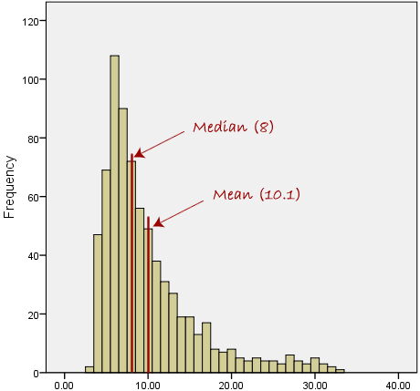
Median is a better option: average salary

Slide 25
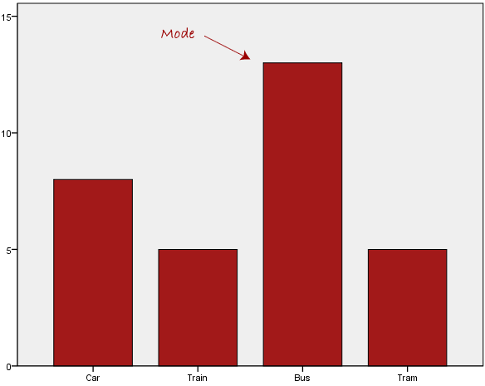
Mode

Slide 26
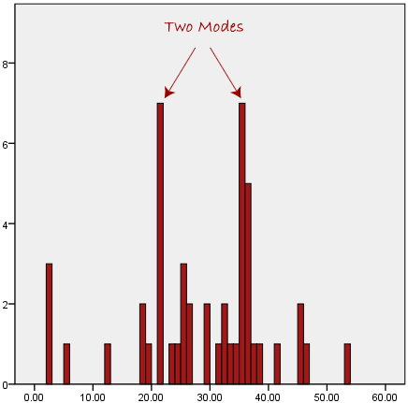
What if two modes??

Slide 27
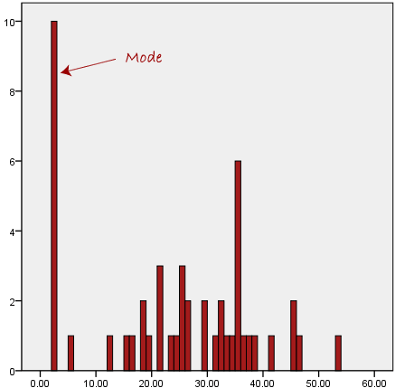
Not suitable when extremely away from normal data

Slide 28
When to use what???
Type of Variable | Best measure of central tendency
Nominal | Mode
Ordinal | Median
Interval/Ratio (not skewed) | Mean
Interval/Ratio (skewed) | Median

Slide 29
Variance measures how far a data set is spread out. The technical definition is “The average of the squared differences from the mean,” but all it really does is to give you a very general idea of the spread of your data. A value of zero means that there is no variability; All the numbers in the data set are the same.
The data set 12, 12, 12, 12, 12 has a var. of zero (the numbers are identical).
The data set 12, 12, 12, 12, 13 has a var. of 0.167; a small change in the numbers equals a very small var.
The data set 12, 12, 12, 12, 13,013 has a var. of 28171000; a large change in the numbers equals a very large number.

Slide 30
Standard Deviation
The square root of the variance is the standard deviation. While variance gives you a rough idea of spread, the standard deviation is more concrete, giving you exact distances from the mean.

Slide 31
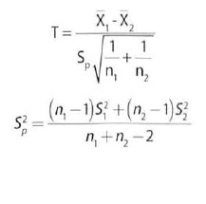
EQ:1

Slide 32
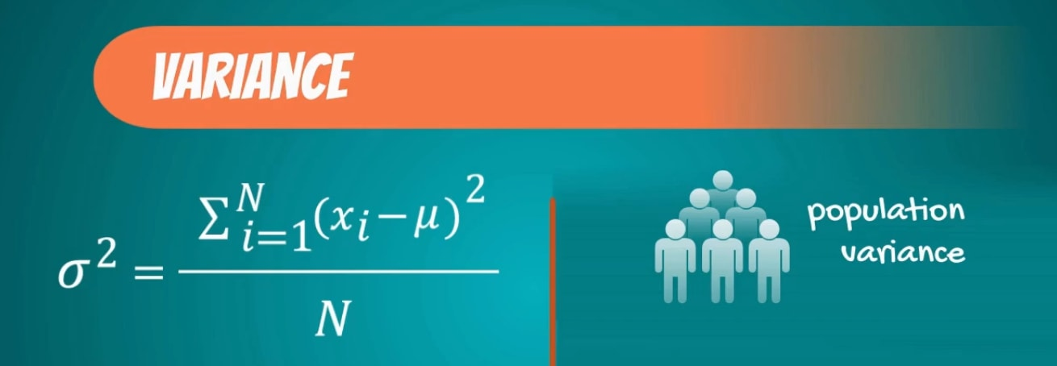
Variance measures the dispersion of a set of data points around their mean value.
Population variance, denoted by sigma squared, is equal to the sum of squared differences between the observed values and the population mean, divided by the total number of observations.
(ref:365datascience.com)

Slide 33
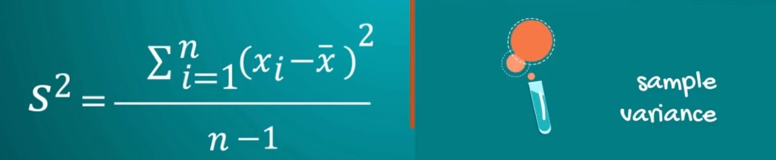
Sample variance, is denoted by s squared and is equal to the sum of squared differences between observed sample values and the sample mean, divided by the number of sample observations minus 1.
Calculate s.d and varience of following
1, 2, 2, 4, 6

Slide 34
Low standard deviation means data are clustered around the mean
high standard deviation indicates data are more spread out.
A standard deviation close to zero indicates that data points are close to the mean,
whereas a high or low standard deviation indicates data points are respectively above or below the mean.

Slide 35
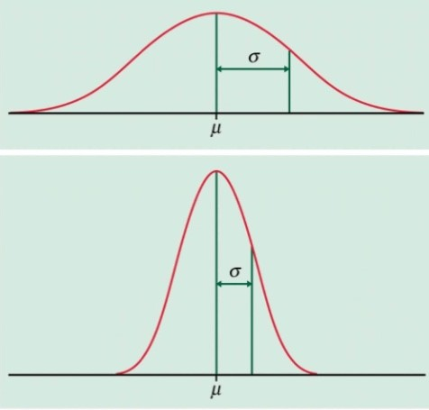
High and low S.D (Source: University of North Carolina, 2012.]

Slide 36
Paper work task
Calculate mean, variance ,standard deviation , median and mode of following sample
9, 2, 5, 4, 12, 7, 8, 11, 9, 3, 7, 4, 12, 5, 4, 10, 9, 6, 9, 4

Slide 37
Home work
Write null and alternative hypothesis
Calculate mean, Median and mode for given data and infer the result
Identify when to chose mean for the given data

